Slide 1
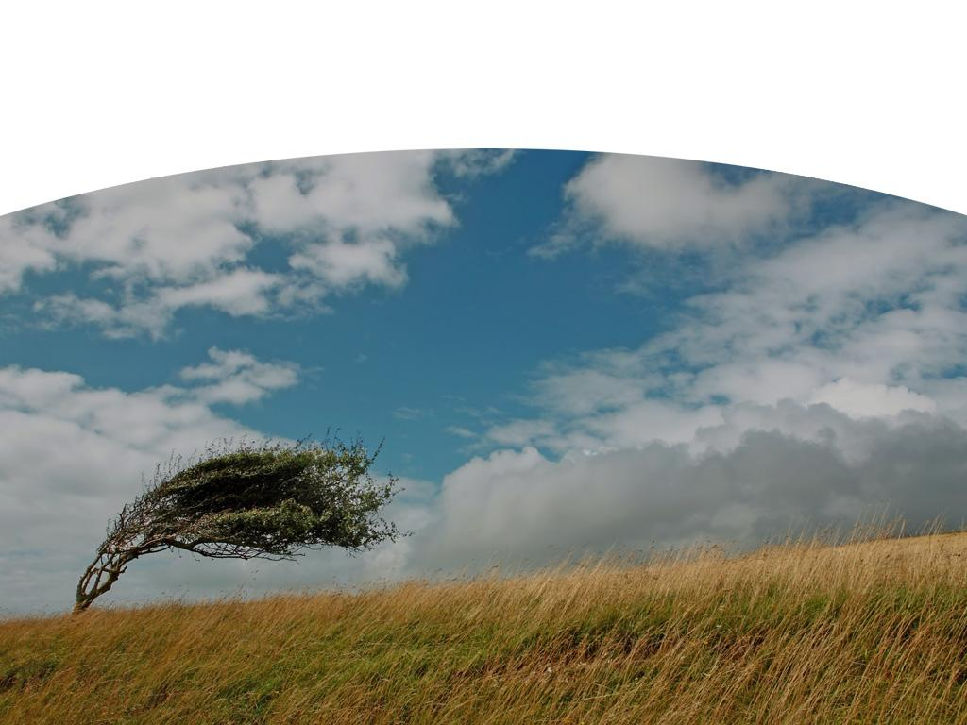
Presentation Title Line 1 and Line 2
Wind Turbine Risk Analysis
Presentation Subtitle Single Line Subtitle Line Two
Dan Bernadett - Global Director of Wind Engineering
15 February 2023
Author, Sponsor or Event Name
Date and Year

Slide 2
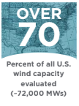
Atmospheric Science, Engineering, and Wind & Solar Technology with Roots to the Very Origins of the U.S. Industry
Evaluated over 70% of all wind projects in the US
Senior Staff 30+ years experience
Conducted first financeable wind assessment in California in 1989
Global experience supporting projects on 6 of 7 continents
45-person team based in US, Brazil, Cape Town, SA, Bangalore, India

Slide 3
Daniel W. Bernadett, P.E.
30 years experience in the wind industry
Global Director of Wind Engineering
“In my 30 years experience in the wind industry, I have not become aware of a member of the public being injured by a wind turbine”
New York State Professional Engineer (license # 073489)

Slide 4
Societal Risk From Wind Turbines
ArcVera conducted a peer review of the DNV report on icing dated 7 October 2014
ArcVera was also asked to quantify the societal risk of blade failure at the proposed ski area expansion
ArcVera found the chance of being hit by a blade fragment was 3625 times lower than the chance of being hit by lightning

Slide 5
Blade Failure Types
Over-speeding and subsequent catastrophic failure of the turbine
Shedding of a single fragment while the turbine is operating

Slide 6
Blade Failure Analysis – Resort Risk
Number | Units | Explanation
476 | years | Return period for any one of seven turbines having single fragment shedding event
833,387,268 | years | Resort risk return period for skier being hit in single fragment event per year
200,000 | years | Return period of a particular turbine over-speeding
87,005 | years | Resort risk return period for skier being hit in over-speeding event per year
86,996 | years | Combined resort risk return period for skier being hit in single fragment or over-speeding event

Slide 7
Blade Failure Analysis – Risk to Individual Guests
Number | Units | Explanation
400,000 | skier-days/year | Maximum ski area build out
0.000000003% | % | Skier risk per day
34,798,324,168 | days | How many ski days between events for a single individual
10 | days | Average days per year a skier participates
3,479,832,417 | years | How many ski years between events for a single individual

Slide 8
Blade Failure Analysis – Risk to Individual Guests
Number | Units | Explanation
960,000 | Years | Return period for person to be struck by lightning
3,625 |  | Times more likely to be hit by lightning than by turbine fragment
292,201,383 |  | Odds of winning powerball lottery jackpot
119 |  | Times more likely to win lottery than be hit by fragment

Slide 9
Thank you!
(Questions?)
Dan.Bernadett@arcvera.com
Golden, CO (GHQ) Bangalore, India Sao Paulo, Brazil Cape Town, South Africa

